Slide 1
Network basics

Slide 2
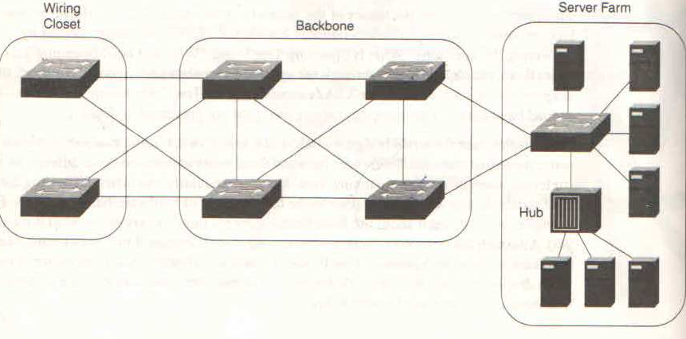
High availability network

Slide 3
High availability network
We notice that there exists multiple paths from various switches and some kind of loop is formed among them
In network loop can cause severe issues
Loops can be formed for verity of reason
To provide redundancy
Loop can be formed due to mistake (unintentional )
Loops can result into
Broadcast storm
Bridge table corruption

Slide 4
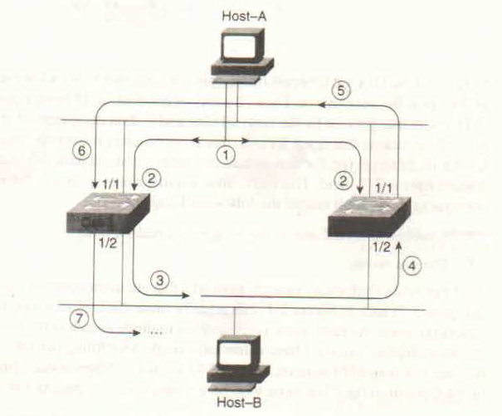
Broadcast creates a feed back loop

Slide 5
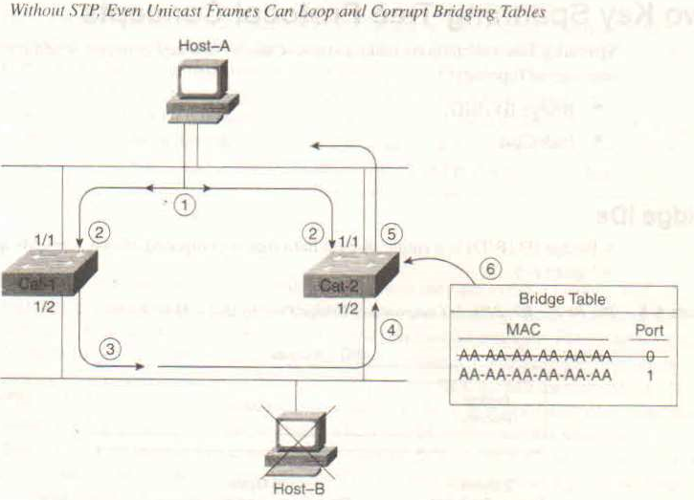
Bridge table corruption

Slide 6
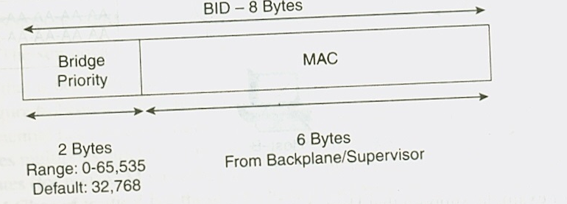
Spanning Tree Protocol
STP is loop avoidance protocol
Key concept
Bridge ID
Path cost
The default bridge priority is 32768

Slide 7
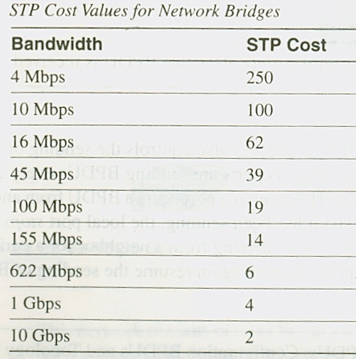
Path cost
802.1D originally defined cost as 1000Mbps divided by bandwidth of the link

Slide 8
STP decision sequence
When creating loop free topology, STP always uses four step decision sequence
Lowest root BID
Lowest path cost
Lowest sender BID
Lowest Port ID
Bridges generate & pass special frame Known as BPDU (Bridge protocol data unit )
It considers all BPDU received on port, and uses the best BPDU
All port send BPDU every 2 second and stop once they receive better BPDU
If more attractive BPDU stops arriving from neighbour for a period of more than 20 seconds the local ports once again can resume sending BPDU
Two types of BPDU
Configuration BPDU
Topology change notification ( TCN ) BPDU

Slide 9
Three steps of STP convergence
Elect one root bridge
Elect root port
Elect designated port

Slide 10
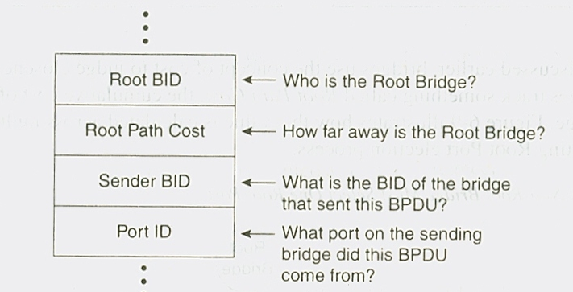
BPDU layout

Slide 11
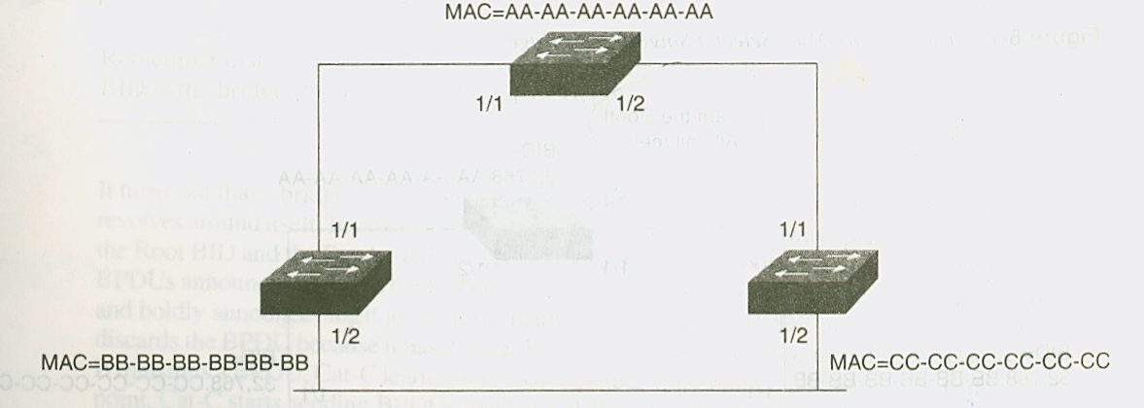
Sample network

Slide 12
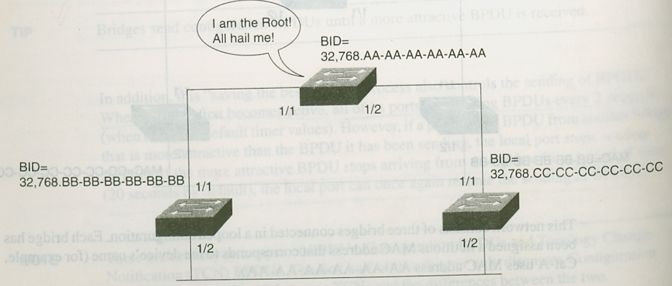
Elect root bridge

Slide 13
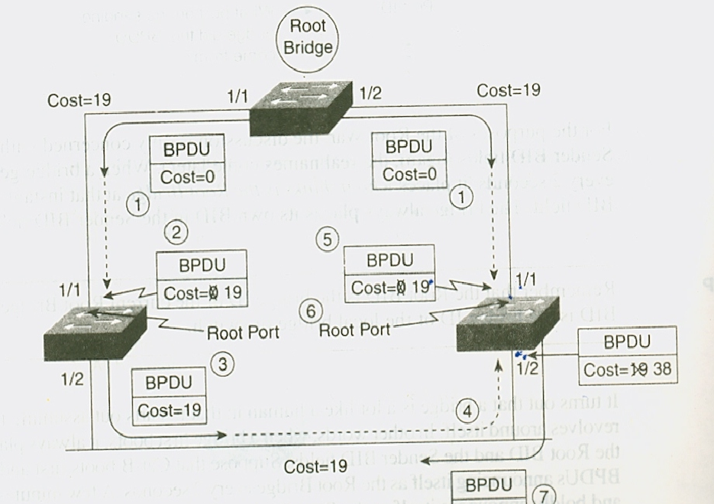
Elect root port
Every non root bridge must select one root port
Root port is port that is closest to root bridge

Slide 14
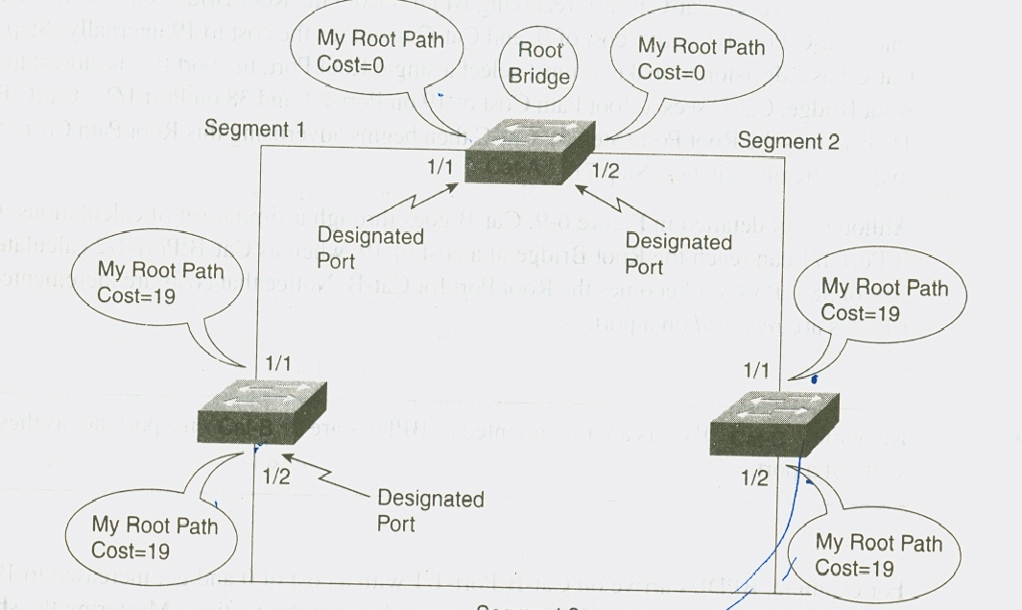
Elect designated Port
Every segment has a designated port and all traffic is sent or received by designated port only

Slide 15
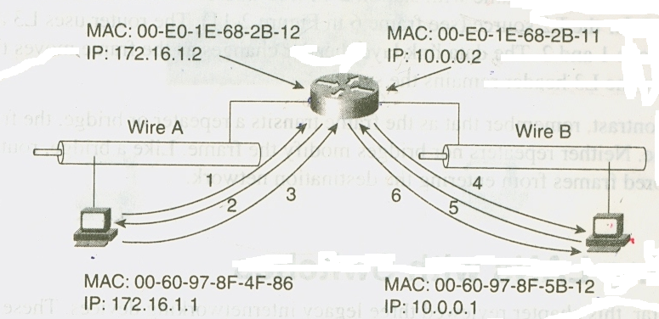
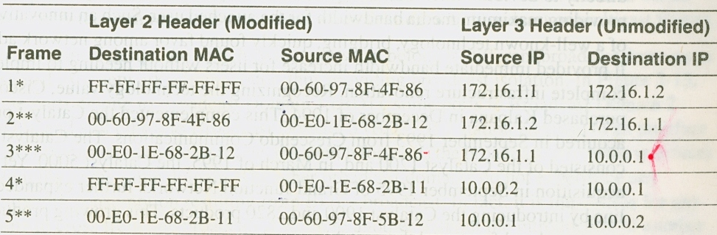
Frame header changes through router
Frame Exchange in a routed network

Slide 16
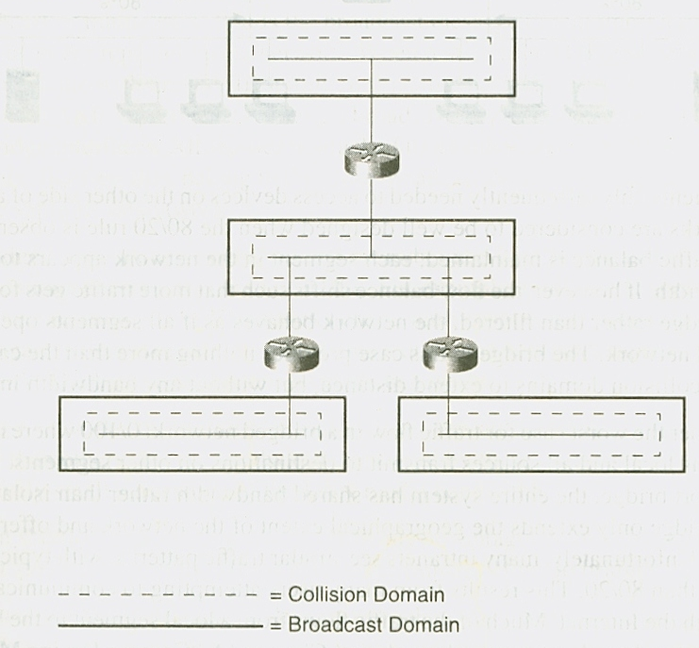
Broadcast and collision domain in routed network

Slide 17
Network
OSI ( Open Standard Interconnect ) Model Has seven layers
Physical, Data Link, Network, Transport, Session, Presentation, and Application.
Fibre Channel does not follow this model, the protocol has been broken into five layers
FC-0, FC-1, FC-2, FC-3, and FC-4
FC-0 to FC-2 contains the physical description of Fibre Channel defined in the FC-PH
FC-3 and FC-4 describe the interface with other applications

Slide 18
What is Channel ?
channel is a closed, direct, structured, and predictable mechanism for transmitting data between relatively few entities.
It provides a direct or switched point-to-point connection between the communicating devices.
once a channel is set up, there is very little decision making needed enabling hardware-intensive environment and transports data at the high speed with low overhead.
Channels are commonly used to connect peripheral devices such as a disk drive, printer, tape drive, etc. to a workstation.
Common channel protocols are Small Computer System Interface (SCSI) and High Performance Parallel Interface (HIPPI).

Slide 19
Network
Networks are aggregations of distributed nodes(like workstations, file servers or peripherals) with there own protocol that support interaction among these nodes.
Networks are unstructured and unpredictable
Networks are able to automatically adjust to changing environments and can support a larger number of connected nodes.
Require decision making in order to successfully route data from one point to another.
Networks have relatively high overhead since they are software-intensive
networks inherently slower than channels.
Examples of common networks are Ethernet, Token Ring, and Fiber Distributed Data Interface (FDDI)

